Slide 1

HINDUSTHAN COLLEGE OF ENGINEERING & TECHNOLOGY
COIMBATORE – 641032
An Autonomous Institution, Approved by AICTE, New Delhi, Affiliated to Anna University, Chennai
Accredited by NBA (AERO, AUTO, CIVIL, CSE, ECE, EEE, IT, MECH, MECHATRONICS)
Accredited by NAAC with ‘A++’ Grade, An ISO Certified Institution
Academic Year – 2023 - 2024 (ODD)
DEPARTMENT OF COMPUTER APPLICATIONS
21CA3001 – MINI PROJECT
Date : 19.12.2023

Slide 2
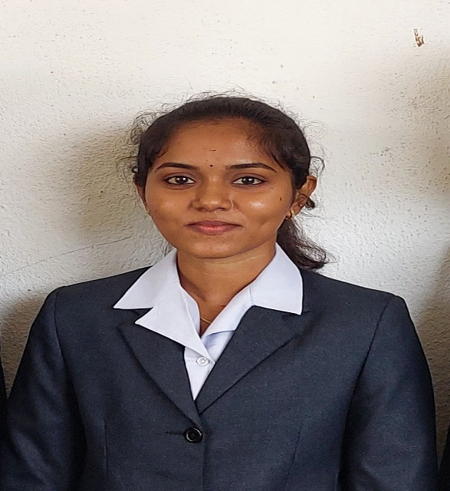
PROJECT TASK SCHEDULER
Name : SAKTHI SWARNA M
Register No : 720722207048
Guided by : Dr. M. Angel Shalini

Slide 3
ABSTRACT
This project is about “Rice Quality Prediction using Digital Image Processing”
Grains, notably rice, drive our agricultural revenue, where milled rice quality defines commercial success.
Human-dependent grain quality testing affects supply chain profitability and burdens farmers.
Assessing varietal purity is laborious, impacting farming practices and productivity.
A model integrating GLCM and support vector machine streamlines quality assessment.
Image processing and CNN aid in diverse rice examination, automating quality evaluation for better agricultural outcomes.

Slide 4
Software Requirements
.NET
SQL SERVER

Slide 5
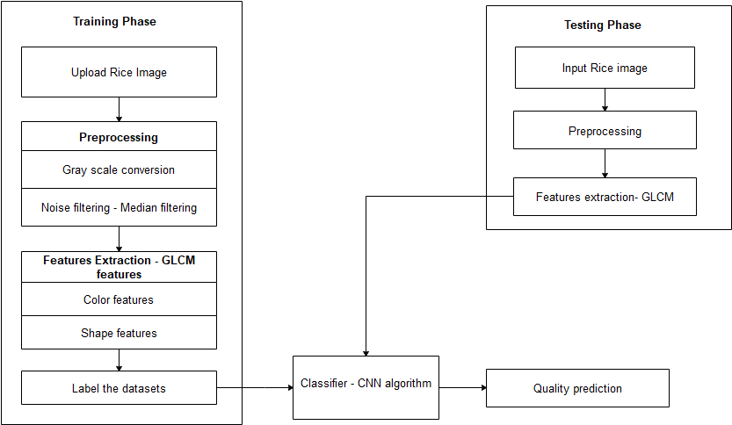
BLOCK DIAGRAM

Slide 6
PROJECT EXPLANATION
Employ digital image processing techniques to analyze rice grain quality parameters like size, shape, color, and defects.
Utilize segmentation and feature extraction algorithms to classify grains based on broken percentage, chalkiness, and purity.
Generate quantitative assessments of quality indicators, providing accurate metrics for rice quality control.
Develop a user-friendly interface to present analysis results, aiding producers and processors in decision-making.
Revolutionize rice quality assessment by automating processes, ensuring food safety and meeting consumer demands efficiently.

Slide 7

PROJECT DEMONSTRATION

Slide 8
CONCLUSION
The project established an image processing technique to discern physical properties for identifying head and broken rice, crucial in rice grading for consumer safety and fair pricing.
Area emerged as the most effective property among perimeter, major, and minor axis lengths for classification, achieving a commendable 98% success rate across various broken rice percentages.
This method offers a swift, uncomplicated, and efficient means of grading, completing operations in just 4 seconds without intricate optimization steps.
Despite its high success rate, further enhancements, like integrating multiple parameters such as area and major axis length, could address undetected broken rice, improving the system's reliability.
Future iterations might explore implementing neural network algorithms to bolster the accuracy of rice quality prediction, expanding the project's potential impact within the industry.

Slide 9
FUTURE ENHANCEMENT
Future enhancements for this project encompass integrating neural networks like CNNs for improved accuracy, exploring multi-property fusion beyond area analysis, and developing defect-specific algorithms for refined classification. Optimization for industrial scalability and real-time analysis aims to seamlessly integrate into existing rice processing machinery. Collaboration with industry stakeholders will refine user interfaces and explore automation, aligning the system with industry standards for streamlined grading.

